Slide 1
JAVA LAB PROJECT PONG GAME
PRESENTED BY: G.Bhavya Bhargavi - 227R1A05E4

Slide 2
TABLE OF CONTENTS
ABSTRACT
INTRODUCTION
KEY FEATURES
CODE
OUTPUT
ADVANTAGES
APPLICATION
CONCLUSION

Slide 3
ABSTRACT
This project presents the development of a classic Pong game in Java, implementing a two-player, graphical, and interactive version of the iconic arcade game. The primary focus is on creating an engaging gaming experience with player-controlled paddles, a bouncing ball, and real-time scoring. The game is designed to run in a graphical user interface (GUI) environment using Java Swing components.

Slide 4
INTRODUCTION
Developing a Pong Game in JavaPong, one of the earliest and most iconic video games, has been captivating players since its introduction in the early days of arcade gaming. This project embarks on the creation of a Java-based Pong game, leveraging the power of object-oriented programming and graphical user interface (GUI) design. The aim is to deliver an engaging and interactive gaming experience, providing players with the classic Pong nostalgia in a modern Java environment.
1. Objective: The primary objective of this project is to develop a two-player Pong game in Java, integrating graphical elements and real-time user interaction. By implementing a game that involves bouncing balls, moving paddles, and dynamic scoring, we intend to demonstrate the versatility and capabilities of Java for game development.
2. Why Pong?:Pong serves as an excellent starting point for game development projects, offering a balance between simplicity and excitement. Its fundamental mechanics—two paddles, a ball, and a scoring system—provide a solid foundation for learning game design principles while allowing for creativity and enhancement in implementation.

Slide 5
KEY FEATURES:
Graphical User Interface (GUI): The game utilizes Java Swing to create an interactive and visually appealing GUI. The window displays the game elements, including paddles, ball, and scoring information.
Two-Player Gameplay: The Pong game supports multiplayer functionality, allowing two players to control their respective paddles independently. Player 1 uses the UP and DOWN arrow keys, while Player 2 uses a separate set of controls.
Real-time Ball Movement: The ball in the game moves dynamically, bouncing off the paddles and walls. The physics of the ball's motion provide an immersive and realistic gaming experience.
Scoring System: A scoring system keeps track of each player's score. Points are awarded when a player successfully hits the ball with their paddle. The scores are displayed in real-time during gameplay.

Slide 6
KEY FEATURES
Game Over Condition: The game implements a win/lose condition based on a predefined number of chances. If a player misses a set number of chances (e.g., five chances), the game concludes, and the final scores are displayed.
AI-controlled Opponent: In single-player mode, an AI-controlled opponent intelligently reacts to the ball's movement, providing a challenging gaming experience.
Game Reset: The game allows for a quick reset after completion, providing the players an option to start a new match.
The implementation leverages object-oriented principles, making the code modular and extensible. Additionally, the game structure follows the Model-View-Controller (MVC) design pattern, enhancing code organization and maintainability.
This Pong game project serves as an educational and entertaining example of Java programming, GUI development, and game logic implementation. It showcases the versatility of Java in creating interactive and dynamic applications, making it suitable for both novice learners and experienced developers.

Slide 7
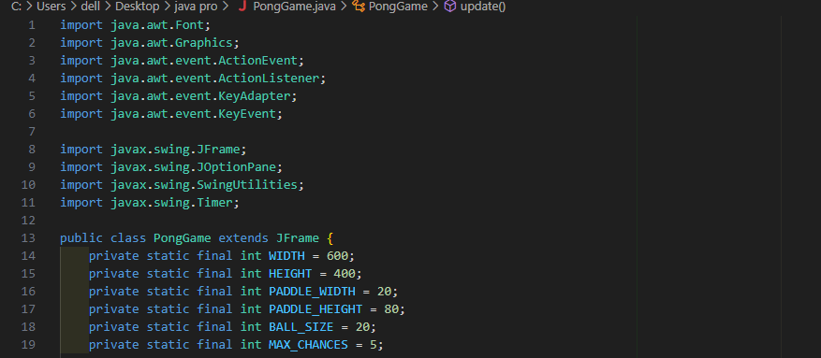
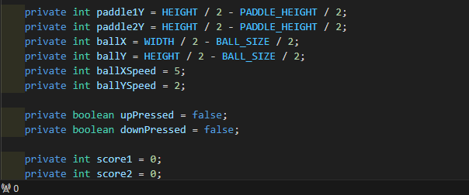
CODE

Slide 8
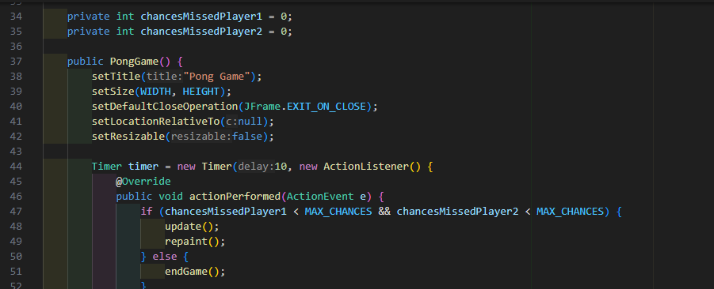
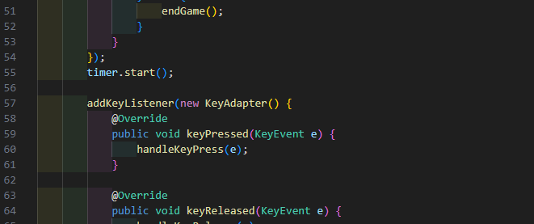
CODE

Slide 9
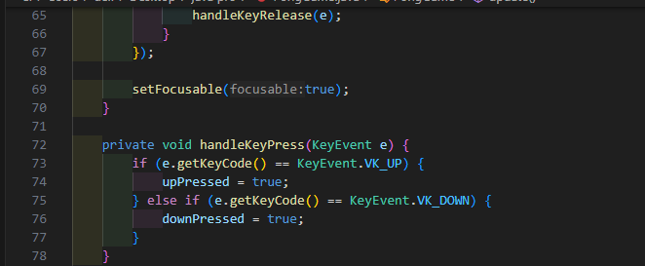
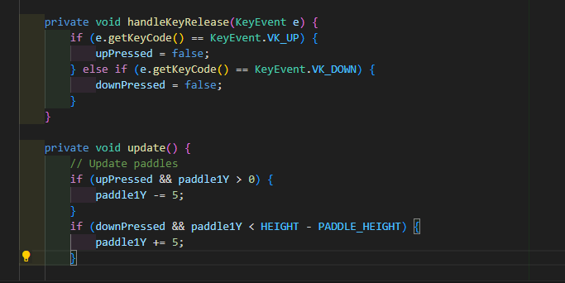
CODE

Slide 10
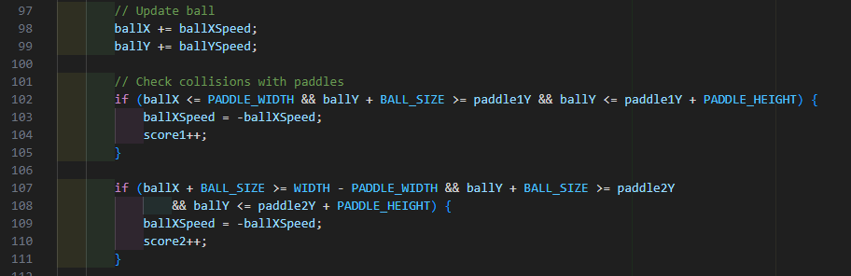
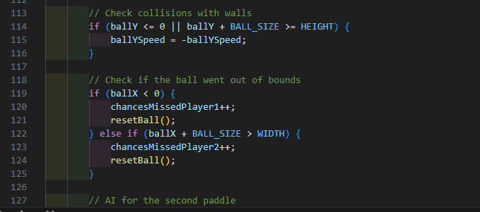
CODE

Slide 11
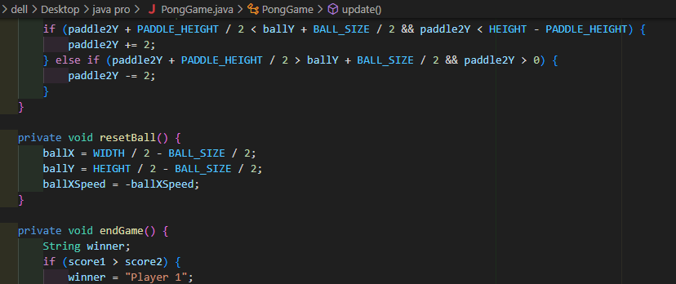
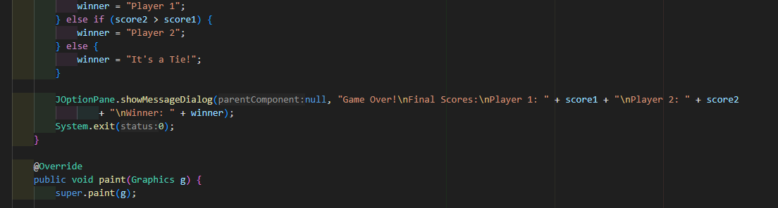
CODE

Slide 12
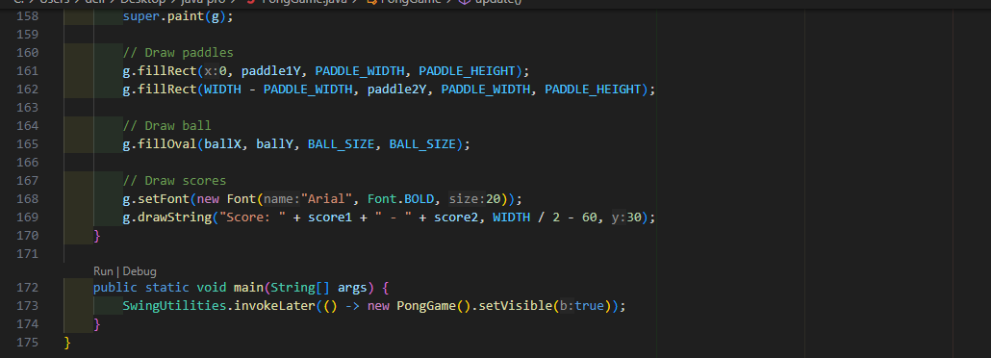
CODE

Slide 13

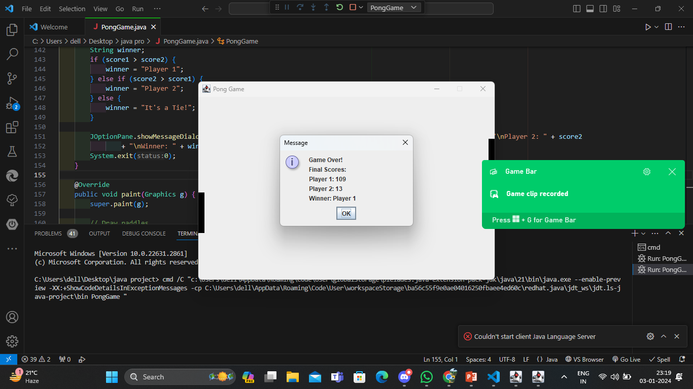
OUTPUT

Slide 14
ADVANTAGES
Platform Independence: Java is known for its platform independence. A Pong game written in Java can run on any system with a Java Virtual Machine (JVM), providing flexibility and accessibility across different operating systems.
Ease of Learning: Java is widely used and has a large community of developers. Learning Java is relatively straightforward, making it an excellent choice for beginners and those looking to understand the basics of game development.
Object-Oriented Programming (OOP): Java is an object-oriented programming language, and this paradigm aligns well with game development. The structure of a Pong game can be organized using classes and objects, promoting modular and maintainable code.
Swing Library for GUI: Java provides the Swing library for building graphical user interfaces (GUIs). Swing simplifies the creation of windows, buttons, and other GUI components, which is essential for designing the user interface of the Pong game.

Slide 15
APPLICATIONS
Introduction to Game Development: Pong is a straightforward game that provides an excellent introduction to the fundamentals of game development. Developing a Pong game allows beginners to understand concepts such as game loops, collision detection, and user input handling.
Java Programming Practice: Creating a Pong game in Java is a practical way to reinforce Java programming skills. It involves working with classes, objects, inheritance, and event-driven programming, which are essential aspects of Java development.
Understanding Game Physics: Pong involves basic physics principles such as ball movement, collisions, and reflection. Implementing these physics concepts in Java helps developers gain insights into how games simulate real-world interactions.
Graphical User Interface (GUI) Design: Java's Swing library is used for creating the GUI of the Pong game. Designing the game's interface introduces developers to GUI components, layout managers, and event handling, which are transferable skills for other Java GUI applications.
Event-Driven Programming: Pong relies heavily on handling user input events, such as keyboard controls. Developing a Pong game helps developers become familiar with event-driven programming, a crucial concept in game development.

Slide 16
APPLICATIONS
Game Loop Implementation: Understanding and implementing a game loop is a fundamental skill in game development. Pong provides a simple yet effective context for developers to grasp the concept of a game loop.
Multiplayer Gaming Concepts: While Pong is typically a single-player or two-player game, implementing a two-player version introduces developers to the basics of multiplayer game development. This can pave the way for more complex multiplayer projects.
Basic Artificial Intelligence (AI): Adding a simple AI opponent to play against in a single-player version of Pong is a common enhancement. This introduces developers to basic AI concepts, such as decision-making and opponent behavior.
Testing and Debugging Skills: Debugging is an integral part of the development process. Creating a Pong game allows developers to practice debugging skills, ensuring that the game functions as expected and identifying and fixing issues.
Cross-Platform Development: Java's platform independence allows Pong games developed in Java to run on various operating systems. This experience can be valuable for understanding the challenges and advantages of cross-platform development.
.

Slide 17
CONCLUSION
In conclusion, developing a Pong game in Java is a highly beneficial and educational endeavor that provides valuable insights and skills for aspiring game developers. Through this project, developers gain proficiency in fundamental game development principles, Java programming, GUI design, event-driven programming, and more. The Pong game project serves as a practical and hands-on experience, offering the following key takeaways like
Java Proficiency
Graphical User Interface (GUI) Design
Practical Application of Algorithms
Debugging and Troubleshooting
Multiplayer Concepts
Event-Driven Programmingetc

Slide 18


